Slide 1


The Importance & Value of
Good Research Ethics
Community Partner Research Ethics Training and Certification
University of Pittsburgh
Michael Yonas, Elizabeth Miller, Maria Catrina D. Jaime and Shannon Valenti
Version 1.0
Copyright, 2014, University of Pittsburgh. All Rights Reserved.
This work is licensed under a Creative Commons Attribution-Non Commercial 4.0 International License http://creativecommons.org/licenses/by-nc/4.0/
Notes:
Developed by: Michael Yonas, Elizabeth Miller, Maria Catrina Jaime and Shannon Valenti

Slide 2
WHAT IS RESEARCH?
An organized way to gather information
Attempts to provide valuable knowledge to serve societal benefit
Has the potential to improve the care or well-being of future generations
Version 1.0
Copyright, 2014, University of Pittsburgh. All Rights Reserved.
This work is licensed under a Creative Commons Attribution-Non Commercial 4.0 International License http://creativecommons.org/licenses/by-nc/4.0/
Notes:
TOPIC SENTENCE: So, what comes to mind when you think of research?
NARRATIVE:
By organized, I mean that there is a structure and a plan for doing the project.
Information is anything we observe or measure about a person.
Valuable Knowledge this can be related to increase information and awareness and better practices
Improve Future “I say society and future generations because research is meant to help other people who were not involved in the project. If the research isn’t going to help anyone after it is done, it shouldn’t be done.
***For example, [ADD EXAMPLE THAT REFLECTS THE ELEMENTS OF THE PROJECT TO DISCUSS AS A GROUP]”
DISCUSSION NOTES:

Slide 3
WHAT ROLES DO WE PLAY IN RESEARCH?
Participant
Researcher
Stakeholder
Partner
Team
  YOU
  Community Agency
  University Staff
  Service and Medical Providers
Version 1.0
Copyright, 2014, University of Pittsburgh. All Rights Reserved.
This work is licensed under a Creative Commons Attribution-Non Commercial 4.0 International License http://creativecommons.org/licenses/by-nc/4.0/
Notes:
TOPIC SENTENCE: There are various people involved in research and each person has various roles
NARRATIVE:
Participant – the person taking part in the research
Researcher – the person conducting the research and seeing how this research works and what can be learned
Stakeholder – can be any group or person invested, interested or potentially gaining information or benefit from the research being done
Partner – can be group or person involved in the research. For instance recruiting participants at their agency or providing services related to the research activities
***For our team, for example SPECIFY ROLES THAT REFLECTS THE ELEMENTS OF THE PROJECT AND RESEARCH TEAM
Team
YOU
Community Agency
University Staff
Service and Medical Providers
DISCUSSION NOTES:

Slide 4
WHAT IS A RESEARCH PARTICIPANT?
Anybody we gather research information about
Information comes from
  experiments
  surveys
  observations
  medical record reviews
  interviews
Version 1.0
Copyright, 2014, University of Pittsburgh. All Rights Reserved.
This work is licensed under a Creative Commons Attribution-Non Commercial 4.0 International License http://creativecommons.org/licenses/by-nc/4.0/
Notes:
TOPIC SENTENCE: What is a research participant? ***ALLOW PEOPLE TO ANSWER AND BEGIN THE DISCUSSION
NARRATIVE:
Basically, it is anyone we gather information about. Anyone whom we observe or make measurement on.
Information can come from a study like XXXX Project. We have specific plans to make measurements about how White- Caucasian and Black -African American women with breast cancer feel, their opinions, and their behaviors about cancer care.
For example project….another way to collect information is to review medical records. For instance, we have a plan to record information from the a Registry about women with breast cancer.
We can also get information from observation. Anytime we record something from watching, video taping, or taking photos of people, we are collecting information about them.
Examples:
Experiment – the effects of cancer treatment and the difference between, gender, race and age.
Observation – gathering a group of male athletes and asking them questions about a violence prevention program conducted by their coach
Medical Records – how frequently do women between the ages of 16-24 receive annual exams
DISCUSSION NOTES:

Slide 5
What REALLY happens when the research begins…
Experience with research
Perception of research
Version 1.0
Copyright, 2014, University of Pittsburgh. All Rights Reserved.
This work is licensed under a Creative Commons Attribution-Non Commercial 4.0 International License http://creativecommons.org/licenses/by-nc/4.0/
Notes:
TOPIC SENTENCE: What really happened when the research begins? Can you please share your research experiences and perceptions? Have they been good or bad?
NARRATIVE:
***DISCUSS with the group THEIR experiences with research, and/or their perceptions and pre conceived ideas of the process, outcomes, experimentation. (NOTE: THIS IS DONE RATHER THAN STARTING OFF WITH A NEGATIVE HISTORICAL REFLECTION OF RESEARCH).
PI should come with positive and negative experiences to share with the group, particularly some related in context/content to the project at hand.
***PREPARE some examples from your OWN experiences to share
DISCUSSION NOTES:

Slide 6
First & Foremost
Good research ethics start with:
Respect for all persons
Consideration of beneficial outcomes
Increased knowledge and information
An attempt to improve health and well being of person(s) in society
Version 1.0
Copyright, 2014, University of Pittsburgh. All Rights Reserved.
This work is licensed under a Creative Commons Attribution-Non Commercial 4.0 International License http://creativecommons.org/licenses/by-nc/4.0/
Notes:
TOPIC SENTENCE: These are the key things we first need to know and understand about good research ethics
NARRATIVE:
Respectful Behaviors includes:
Listening to the participants needs and concerns
Providing clear and understandable information
Allowing the person to make an informed decision
Persons includes:
Participant – person(s) participating in the study
Research staff – people conducting the study
Society – people who can be affected by research outcomes and results
***DISCUSS the increased knowledge/information and benefits SPECIFIC to your PROJECT. Prepare general examples.
DISCUSSION NOTES:

Slide 7
Scenario 1
In an urban community-based after-school program information was shared with parents about their child's participation in a childhood asthma project
Version 1.0
Copyright, 2014, University of Pittsburgh. All Rights Reserved.
This work is licensed under a Creative Commons Attribution-Non Commercial 4.0 International License http://creativecommons.org/licenses/by-nc/4.0/
Notes:
READ NARRATIVE OF SCENARIO 1:
My child is participating in an urban community-based after-school program and information was shared about participation in a childhood asthma project to learn about perceptions of influences in the community that impact children’s asthma. The study staff made multiple community presentations about the study to local parents and others from organizations to share background and answer any questions regarding the research project, background and research in general. The study times and locations identified were guided by feedback from the me and other participants/families in order to make participation as easy as possible. The formal consent process was well done, clearly explained and answered any questions we had and we were reminded that study participation was voluntary throughout the project. I continue to receive information about the project and had such a good experience with the first part I have now become involved as an advisory board member. The PI and staff working on the project work with children on a regular basis and our study visits are very comfortable, they are patient and collaborative at every phase…and are able to communicate with me by phone, email and text message regarding details of the project.

Slide 8
What Does Good Ethical Research Look Like?
Scenario 1:
Participant – Children with Asthma
Research Staff – Experienced in working with children with asthma
Outcome – Parents and participating child are highly involved and compliant with the research due to staff practice of good treatment and ethics during the study
Version 1.0
Copyright, 2014, University of Pittsburgh. All Rights Reserved.
This work is licensed under a Creative Commons Attribution-Non Commercial 4.0 International License http://creativecommons.org/licenses/by-nc/4.0/
Notes:
TOPIC SENTENCE: What does good research ethics look like? Lets review this scenario I just read…..
NARRATIVE:
***DISCUSS the outlined bullet points in the slide, IDENTIFY the people involved and how the POSITIVE outcome came about in this scenario
DISCUSSION NOTES:

Slide 9
Identify Good Research Ethics Principles Used
Research staff …….
Accommodated child’s and parent’s needs
Consent process conducted thoroughly and provided clear understanding
Provided follow up information regarding findings and project next steps
Version 1.0
Copyright, 2014, University of Pittsburgh. All Rights Reserved.
This work is licensed under a Creative Commons Attribution-Non Commercial 4.0 International License http://creativecommons.org/licenses/by-nc/4.0/
Notes:
TOPIC SENTENCE: Lets identify the good research ethics used in this scenario
NARRATIVE:
***ALLOW GROUP TO IDENTIFY the SPECIFIC things from outlined bullet points in the slide
Accommodated child’s and parent’s needs
They were CONSIDERATE of the participants/families feedback regarding study times and locations
They were willing to make it EASIER for participants/families schedules, NOT just the project schedule
Consents were conducted thorough and clear
They took the TIME to EXPLAIN and ANSWER questions
They reminded participants that study participation was VOLUNTARY
They were experienced working with children and made them COMFORTABLE
Provided follow up information
They kept participant INFORMED throughout the project
They ALWAYS made themselves available via phone, email and text message
RESULT: The participant had good compliance with project and their experience was so positive it led to participant becoming involved as an advisory board member for the project

Slide 10
Scenario 2
In high school setting a violence prevention research project was recruiting male athletes grades 9th-12th
Version 1.0
Copyright, 2014, University of Pittsburgh. All Rights Reserved.
This work is licensed under a Creative Commons Attribution-Non Commercial 4.0 International License http://creativecommons.org/licenses/by-nc/4.0/
Notes:
READ NARRATIVE OF SCENARIO 2:
During a violence prevention research project with high school male athletes, parent consent forms were distributed to minors to take home for parents to review and sign in order for each athlete to participate in anonymous survey. Parent consent form contained an introductory letter and contact information for the lead researcher (also called the PI). A parent called having questions about the study and general concerns regarding her son’s behavior problem. The PI continued follow up and addressed parent’s follow up questions about the study and discussed the parents’ concerns about son’s behavior problems. Parent had positive reaction in regards to the PIs follow up, especially her willingness to talk about parents’ concerns about son’s behavior problems. Within the following week the athlete returned with signed parent consent form and before his participation research staff also reviewed with him his assent form before participating in the survey.

Slide 11
What Does Good Ethical Research Look Like?
Scenario 2:
Participant – High School Male Athlete
Research Staff – Worked in community based research projects
Outcome – Staff addressed parent’s concerns and developed an open, honest and comfortable relationship with parent and participant
Version 1.0
Copyright, 2014, University of Pittsburgh. All Rights Reserved.
This work is licensed under a Creative Commons Attribution-Non Commercial 4.0 International License http://creativecommons.org/licenses/by-nc/4.0/
Notes:
TOPIC SENTENCE: What does good research ethics look like? Lets review this scenario I just read…..
NARRATIVE:
***DISCUSS the outlined bullet points in the slide, IDENTIFY the people involved and how the POSITIVE outcome came about in this scenario
DISCUSSION NOTES:

Slide 12
Identify Good Research Ethics Principles Used
Research staff …….
Consent process was conducted properly with participant and parent
Promptly followed up with parent’s concerns
Provided support regarding non-study related concerns
Version 1.0
Copyright, 2014, University of Pittsburgh. All Rights Reserved.
This work is licensed under a Creative Commons Attribution-Non Commercial 4.0 International License http://creativecommons.org/licenses/by-nc/4.0/
Notes:
TOPIC SENTENCE: Lets identify the good research ethics used in this scenario
NARRATIVE:
***ALLOW GROUP TO IDENTIFY the SPECIFIC things from outlined bullet points in the slide
Consents were conducted properly with BOTH minor and parent
Minor – Properly given his OWN ASSENT to participate or not in the study, NOT SOLELY based on the parent’s permission
Parent – Given parent consent along with additional informational letter to better understand the study
Promptly followed up with parent’s concerns & Provided support regarding additional concerns not related to the study
PI followed up followed up and ANSWERED the parent’s CONCERNS about her son, NOT just about the study
RESULT: Parent had positive interaction due to the PIs follow up, which led to the athlete returning a properly signed parent consent form and the athlete was also properly consented by research staff for his willingness to participate in the survey.

Slide 13
Scenario 3
At the Veterans Affairs (VA) Hospital a research study was conducting a randomized trial with alcoholic liver disease patients
Version 1.0
Copyright, 2014, University of Pittsburgh. All Rights Reserved.
This work is licensed under a Creative Commons Attribution-Non Commercial 4.0 International License http://creativecommons.org/licenses/by-nc/4.0/
Notes:
READ NARRATIVE OF SCENARIO 3:
At the VA hospital, a research study was being conducted which involved randomizing alcoholic liver disease patients and recruitment of comparison groups including healthy and active drinkers. IRB approved recruitment of active drinkers with stipulation that research staff could not actively recruit at bar or drinking establishments when potential participants were under the influence. Research staff established relationships with bartenders and asked permission to post flyers regarding the study. As interested participants called and followed up, one participant came as an active drinker and after his screening detected liver disease. Physician followed up and consulted with participant. After options were presented, patient decided to participate in the study. The patient was supported by the study to maintain his sobriety and complete physician visits regularly. After the study completed, patient established care with study physician at her clinic and continued follow up care. The client expressed his gratitude saying that if he had never participated in the study, he would have never known he had liver disease and his health condition would have ended his life. He attributed his new found health and well-being to the physician and the research study.
NOTE – Explain randomized - When a study to compare 2 or more ways of doing things, it is best to put people into groups randomly. It is the best way to see if one way of doing things is better than the other. When randomly placing people into groups, its good to explain that we do not know which group will do better, hence why the study is being conducted. This is important not to tell people they may get a “good” treatment or a “bad” treatment. We don’t really know which treatment is better. For randomization to be fair, it should be decided by chance, like flipping a coin.

Slide 14
What Does Good Ethical Research Look Like?
Scenario 3:
Participant – Alcoholic Liver Disease Patients
Research Staff – Physician expertise in care and treatment
Outcome – Participant was connected with the study; care was provided to improve his health condition
Version 1.0
Copyright, 2014, University of Pittsburgh. All Rights Reserved.
This work is licensed under a Creative Commons Attribution-Non Commercial 4.0 International License http://creativecommons.org/licenses/by-nc/4.0/
Notes:
TOPIC SENTENCE: What does good research ethics look like? Lets review this scenario I just read…..
NARRATIVE:
***DISCUSS the outlined bullet points in the slide, IDENTIFY the people involved and how the POSITIVE outcome came about in this scenario
DISCUSSION NOTES:

Slide 15
Identify Good Research Ethics Principles Used
Research staff …….
Consulted treatment options regarding patient’s health condition
Provided expertise after study completion
Improved the care and well-being of participant
Version 1.0
Copyright, 2014, University of Pittsburgh. All Rights Reserved.
This work is licensed under a Creative Commons Attribution-Non Commercial 4.0 International License http://creativecommons.org/licenses/by-nc/4.0/
Notes:
TOPIC SENTENCE: Lets identify the good research ethics used in this scenario
NARRATIVE:
***ALLOW GROUP TO IDENTIFY the SPECIFIC things from outlined bullet points in the slide
Proper follow up treatment regarding patient’s conditions
Physician – Properly provided her expertise and followed up to help patient deal with his health condition
Provided expertise after study completion
PI continued follow up after the study to establish continued care for the patient
Improved the care and well-being of participant
Study helped detect patient’s health condition which led to improved health outcomes.
Results: Patient health condition was identified through the study screening and follow up support was provided to help treat his liver disease. Even when the study ended the patient established continued follow up care with the study physician. Overall, the study needs were met but more importantly patient health and well-being was improved.

Slide 16
Scenario 4
At a doctors office researchers were recruiting patients for a dermatology study
Version 1.0
Copyright, 2014, University of Pittsburgh. All Rights Reserved.
This work is licensed under a Creative Commons Attribution-Non Commercial 4.0 International License http://creativecommons.org/licenses/by-nc/4.0/
Notes:
READ NARRATIVE OF “BAD” SCENARIO :
At the doctor’s office, while lying face down and having a clinical procedure done to my back, a staff member asked if she could take a picture of my back. Being that I was there for a clinical procedure, I was under the impression it was for clinical purposes. I agreed. She got the camera and then said “oh, I guess I should have you sign this first”. I’m face down, so I prop myself up as much as I could, read the document, and it was for a research study where they were taking images for research purposes and sharing them among different research sites. Definitely not a consent process, and definitely uncomfortable. I did end up participating in the study because the research was interesting and the de-identified images were being used as comparisons for people with the same problem as mine, but I was very unhappy with the consenting process.

Slide 17
What Does BAD Research Ethics Look Like?
Scenario 4:
Participant – Patient coming in for clinical procedure
Research Staff – Recruited patient before a clinical procedure
Outcome – Unpleasant consent process and poor research ethics
Version 1.0
Copyright, 2014, University of Pittsburgh. All Rights Reserved.
This work is licensed under a Creative Commons Attribution-Non Commercial 4.0 International License http://creativecommons.org/licenses/by-nc/4.0/
Notes:
TOPIC SENTENCE: What does BAD research ethics look like? Lets review this scenario I just read…..
NARRATIVE:
***DISCUSS the outlined bullet points in the slide, IDENTIFY the people involved and how the NEGATIVE outcome came about in this scenario
DISCUSSION NOTES:

Slide 18
Identify Negative/bad characteristics of Research Ethics
Research staff …….
Approached participant during an uncomfortable situation
Did NOT provide proper or respectful consent process
Made participant unhappy and uncomfortable
Version 1.0
Copyright, 2014, University of Pittsburgh. All Rights Reserved.
This work is licensed under a Creative Commons Attribution-Non Commercial 4.0 International License http://creativecommons.org/licenses/by-nc/4.0/
Notes:
TOPIC SENTENCE: Lets identify the good research ethics used in this scenario
NARRATIVE:
***ALLOW GROUP TO IDENTIFY the SPECIFIC things from outlined bullet points in the slide
Approached participant during an uncomfortable situation
Patient was prepared for clinical procedure and was caught off guard, especially being partially undressed and laying face down on table.
Did NOT provide proper or respectful consent process
Patient was not in approachable position to talk to nor was it a good way to explain the consent
Made participant unhappy and uncomfortable
Poor consent process left the participant disappointed and disrespected. This type of harm and risk should be avoided, should not occur
OVERALL – Poor research ethics
Disrespectful of the patient’s privacy during her clinical visit
Patient was not properly informed about the research study
Patient was rushed and pressured to participate and sign the consent form
Overall experience was not respectful or comfortable for the patient

Slide 19
Reflection
Can you think of 1 or 2 good or bad examples of research ethics?
Version 1.0
Copyright, 2014, University of Pittsburgh. All Rights Reserved.
This work is licensed under a Creative Commons Attribution-Non Commercial 4.0 International License http://creativecommons.org/licenses/by-nc/4.0/
Notes:
TOPIC SENTENCE: Can you think of 1-2 good or bad examples of research ethics…….
***This is the time/space to DISCUSS WITH THE GROUP THEIR experiences with research, and particularly aspects of research ethics…given what was just covered.
NARRATIVE:
(NOTE: THIS IS DONE RATHER THAN STARTING OFF WITH A NEGATIVE HISTORICAL REFLECTION OF RESEARCH).
PI should come with positive and negative experiences to share with the group, particularly some related in context/content to the project at hand.
This is a time of open reflection, no right or wrong…in a brainstorming type of fashion. Also a time to clarify for the group, answer questions about WHAT research ethics are, if needed.
DISCUSSION NOTES:

Slide 20
Covering All Aspects of Good Research Ethics
History
Guiding Principles
Rules
Privacy
Version 1.0
Copyright, 2014, University of Pittsburgh. All Rights Reserved.
This work is licensed under a Creative Commons Attribution-Non Commercial 4.0 International License http://creativecommons.org/licenses/by-nc/4.0/
Notes:
TOPIC SENTENCE: We are going to cover the history, guiding principles, rules and privacy involved in good research ethics
NARRATIVE:
For this session, we will discuss this issue of protecting people who participate in research.
To start this, we will talk about some of the history of research projects done with people and why we need to be very careful about protecting participants.
Because of bad things that happened throughout history, guiding principles were developed to help us protect participants!!!!
From the guiding principles, we have established ground rules.
The last topic we will talk about is privacy. Privacy for participants is one way to offer protection, particularly in the type of research you will be involved in.
DISCUSSION NOTES:

Slide 21
HISTORY
What has happened in the past?
  History --> guidelines --> rules
Helps us understand the guidelines
We don’t want to make the same mistakes again!
Version 1.0
Copyright, 2014, University of Pittsburgh. All Rights Reserved.
This work is licensed under a Creative Commons Attribution-Non Commercial 4.0 International License http://creativecommons.org/licenses/by-nc/4.0/
Notes:
TOPIC SENTENCE: Lets review the history…….
NARRATIVE:
I’m going to spend a fair amount of time going over problems that happened in the past. These events led to rules that now protect research participants. The cases I will tell you about are the worst case examples and are very uncommon. Most research doesn’t harm the participant at all.
These mistakes from the past have led to the rules and regulations needed to help ensure we do not make these same mistakes again.
DISCUSSION NOTES:

Slide 22
Historical Events have informed existing guidelines
NUREMBERG CODE: “RULES FOR TREATING PARTICIPANTS”
  Set the research standards
  Outlined rules for conducting research
DECLARATION of HELSINKI
  Expanded standards for consent process, participant and researcher relationship and research guidelines
The Belmont Report
  CORE research ethics: Respect, Beneficence & Justice
Version 1.0
Copyright, 2014, University of Pittsburgh. All Rights Reserved.
This work is licensed under a Creative Commons Attribution-Non Commercial 4.0 International License http://creativecommons.org/licenses/by-nc/4.0/
Notes:
TOPIC SENTENCE: Listed are a few key historical events that led to the development of these existing guidelines…….
NARRATIVE: Because of the events in Nazi Germany and the facts that came out of the trials lead to the development of basic rules for how we treat participants in research. The patient must volunteer to participate. The research must help society. We should be able to use the result to help others. Research should be based on previous knowledge. This is a bit more tricky. This basically means that we should have good reason to believe that it will work. The research should not cause mental and physical suffering and avoid risk of injury and death. The research should not make things dangerous for participants.
Nuremberg Code:
Voluntary agreement of the participant is required
Research must have potential to help society
Research should be based on previous knowledge
Should not cause mental and physical suffering, and avoid risk of injury and death
Amount of risk must not be more than the importance of the problem
Qualified researchers
Participant must be free to stop at any time
Researcher must be prepared to stop if there is risk of injury, disability or death
Declaration of Helsinki:
Consent should be in writing
Research should build on previous work
Research must follow written plan
Review by an independent committee
Caution if participant is in dependent relationship with researcher
Participants must receive best proven care
BELMONT REPORT
Respect - Voluntary consent & Protect those who cannot make decisions
Beneficence - Maximize benefits & minimize risk of harm
Justice - The burdens and benefits of research should be distributed fairly
DISCUSSION NOTES:

Slide 23
Who is the Institutional Review Board (IRB)?
Institutional Review Board (IRB) is in charge of protecting the rights and welfare of people involved in research.
Consists of review committees, IRB coordinators, technical support and administrative personnel
Website of University of Pittsburgh IRB
http://www.irb.pitt.edu/default.aspx
Version 1.0
Copyright, 2014, University of Pittsburgh. All Rights Reserved.
This work is licensed under a Creative Commons Attribution-Non Commercial 4.0 International License http://creativecommons.org/licenses/by-nc/4.0/
Notes:
TOPIC SENTENCE: Who is the IRB….
NARRATIVE:
***REVIEW the outlined bullet points in the slide and use an EXAMPLE from the case scenarios of how the IRB would look at the different scenarios, who would review, so forth…
IRB helps set up to structure and support for GOOD ethical research.
Listed below are the things IRB helps with and provides information about:
Regulatory Questions (Including FederalWide Assurance Issues)
General Questions Regarding IRB Office Operations
Administration
IRB Vice Chairs
Exempt/Expedited Studies
Full Board Studies
Adverse Events
Education (New coordinator orientations, new board member orientations, pre-screens...)
Technical Support
DISCUSSION NOTES:

Slide 24
What the IRB can do?
Provide support and guidelines on how to conduct ethical research
Review and approve research studies
Review study modifications, renewals, unanticipated problems, and adverse events
Protect human subjects involved in ongoing IRB-approved research
Version 1.0
Copyright, 2014, University of Pittsburgh. All Rights Reserved.
This work is licensed under a Creative Commons Attribution-Non Commercial 4.0 International License http://creativecommons.org/licenses/by-nc/4.0/
Notes:
TOPIC SENTENCE: What does the IRB do…..
NARRATIVE:
***REVIEW the outlined bullet points in the slide and AGAIN use an EXAMPLE from the case scenarios of how the IRB would look at the different scenarios, who would review, so forth…
Important to show that IRB helps set up to structure and support for GOOD ethical research.
DISCUSSION NOTES:

Slide 25
APPLYING GUIDELINES
Principle | Applications
Respect for Persons | Informed consent Privacy (Confidentiality and Anonymity)
Beneficence | Protecting participants from harm Assessment of risks and benefits
Justice | Choosing participants
Version 1.0
Copyright, 2014, University of Pittsburgh. All Rights Reserved.
This work is licensed under a Creative Commons Attribution-Non Commercial 4.0 International License http://creativecommons.org/licenses/by-nc/4.0/
Notes:
TOPIC SENTENCE: How it all comes together, this is how we apply these guidelines……
NARRATIVE:
***REVIEW the outlined bullet points in the slide and REFLECT BACK ON THE SCENARIOS AND MAKE CONNECTIONS WITH THE GUIDELINES
For the respect for persons, we try to make sure that participants give us informed consent. Have any of you given consent for research before? For anything else? What did you think about the information you were given? Did you feel like you were informed? Was there anything about the process that you did not like?
Another way we respect people is by guaranteeing their privacy. I’m going to talk a bit more about that in a few slides.
For beneficence, we try to protect participants from harm and make sure that the benefits outweigh the risks.
For justice, we try to make sure we are including those who could benefit and not take advantage of some people to benefit others. We also don’t want to prevent people from participating who may benefit.
DISCUSSION NOTES:

Slide 26
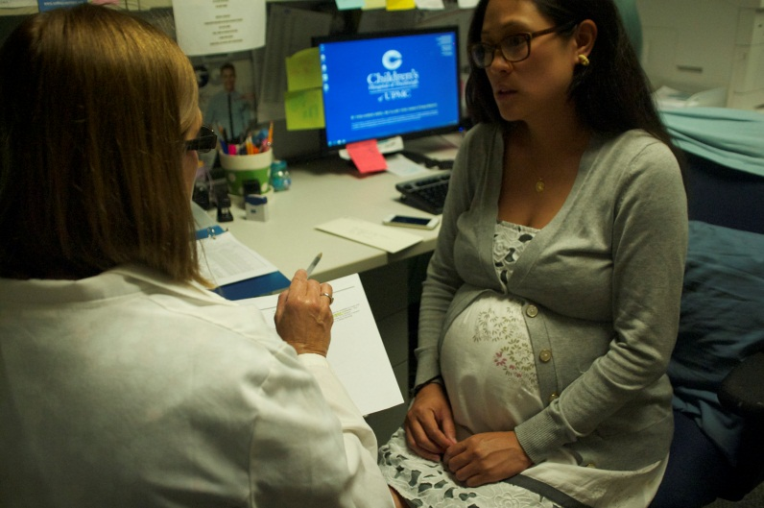
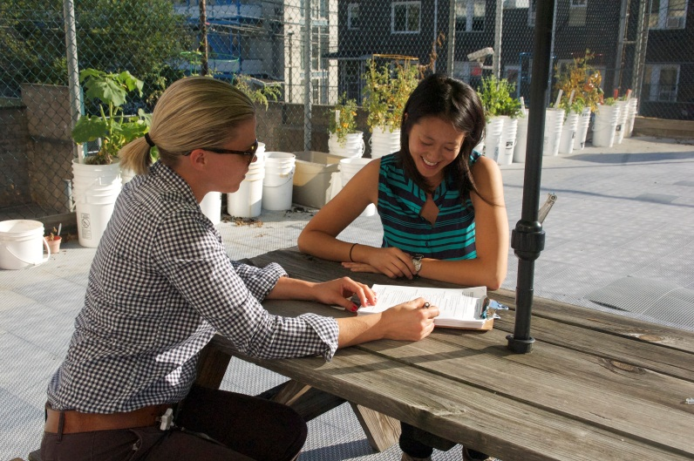
INFORMED CONSENT
“GETTING PERMISSION FROM RESEARCH PARTICIPANTS”
Consent is a PROCESS...
  Researcher describes research study
  Participant has chance to ask questions and time to make a decision about whether to participate
  Researcher answers questions
  Participant signs a consent form agreeing to participate
Version 1.0
Copyright, 2014, University of Pittsburgh. All Rights Reserved.
This work is licensed under a Creative Commons Attribution-Non Commercial 4.0 International License http://creativecommons.org/licenses/by-nc/4.0/
Notes:
TOPIC SENTENCE: Consequently, getting permission from research participants is a process to make sure they understand what is “consent.”
NARRATIVE:
***REVIEW the outlined bullet points in the slide and REFLECT BACK ON THE SCENARIOS TO CONNECT WITH INFORMED CONSENT
***GIVE EXAMPLE(s) from specific research study
***PROVIDE the group members a training with an example of YOUR INFORMED CONSENT FORM…
DISCUSSION NOTES:

Slide 27
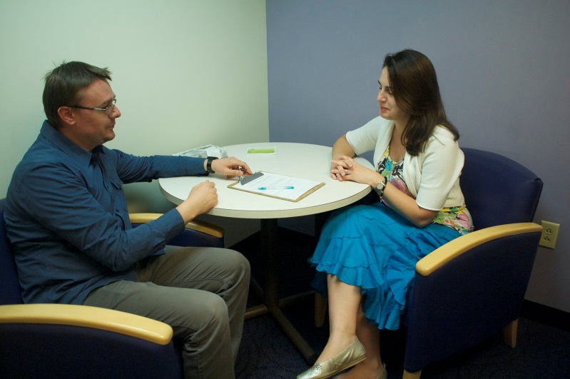
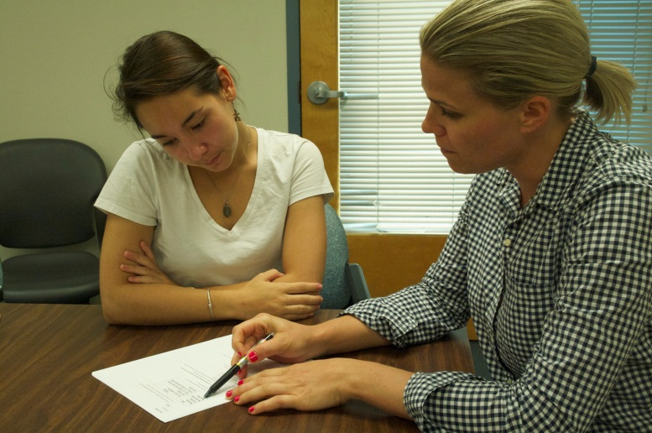
INFORMED CONSENT
“GETTING PERMISSION FROM RESEARCH PARTICIPANTS” CONTINUED
Consent is a PROCESS...
Highlights:
  The fact that this is RESEARCH
  Description of study, duration, nature of tasks, and source of participants
  Risks and/or benefits
  Compensation or state if there are no payments for participation
  How confidentiality will be maintained
  That participation is voluntary
  Participant can withdraw at any time
  Contact person for research
Version 1.0
Copyright, 2014, University of Pittsburgh. All Rights Reserved.
This work is licensed under a Creative Commons Attribution-Non Commercial 4.0 International License http://creativecommons.org/licenses/by-nc/4.0/
Notes:
TOPIC SENTENCE: Consequently, getting permission from research participants is a process to make sure they understand what is “consent.”
NARRATIVE:
***REVIEW the outlined bullet points in the slide and REFLECT BACK ON THE SCENARIOS TO CONNECT WITH INFORMED CONSENT AND FURTHER DISCUSSION OF THESE DETAILS OUTLINED
DISCUSSION NOTES:

Slide 28
UNDERSTANDING CONSENT
Clearly written
Everyday words
Plan for participants who cannot read
Plan for participants who are not English speakers
Plan for participants who may have additional needs to comprehend consent language
Version 1.0
Copyright, 2014, University of Pittsburgh. All Rights Reserved.
This work is licensed under a Creative Commons Attribution-Non Commercial 4.0 International License http://creativecommons.org/licenses/by-nc/4.0/
Notes:
TOPIC SENTENCE: These are components that help ensure that the consent process is complete and understood by the participants
NARRATIVE:
***REVIEW the outlined bullet points in the slide and DISCUSS IMPORTANCE UNDERSTANDING “CONSENT”
DISCUSSION NOTES:

Slide 29
ACTIVITY
Practicing Informed Consent Process
[10-15 minutes]
Version 1.0
Copyright, 2014, University of Pittsburgh. All Rights Reserved.
This work is licensed under a Creative Commons Attribution-Non Commercial 4.0 International License http://creativecommons.org/licenses/by-nc/4.0/
Notes:
TOPIC SENTENCE: We are going to practice informed consent process and do some role playing to help us better understand this process.
NARRATIVE:
****Investigator provide copies of their Informed Consent Forms associated with their study or another study to practice. Switching roles as participant and community-researcher.
THIS IS A GREAT ACTIVITY AND PROCESS TO PRACTICE, and also strengthen new relationships..
Participant roles should vary, for example:
a compliant participant,
an uncertain participant,
a participant that does not and decides NOT to participate.
PI will assign these respective participant role so that the community-researcher DOES NOT know.
DISCUSSION NOTES:

Slide 30
WHO CAN GIVE CONSENT?
In Pennsylvania:
  For minors (age 17 or younger), parent or legal guardian
  For adults (18 or older) can consent for themselves, unless mentally unable, then “proxy” consent used
EXAMPLES
  Teenage mother can consent for her child but not herself
  If IRB waives parent consent, minor can assent to participation
  Parental consent with minor “assent”
Discussion of Scenarios
Version 1.0
Copyright, 2014, University of Pittsburgh. All Rights Reserved.
This work is licensed under a Creative Commons Attribution-Non Commercial 4.0 International License http://creativecommons.org/licenses/by-nc/4.0/
Notes:
TOPIC SENTENCE: Who can give consent?
NARRATIVE:
***REVIEW the outlined bullet points in the slide and REFLECT applying the knowledge….How could this happen in YOUR project?
*If appropriate, can review sampling procedures and implications… such as:
Snowball Sampling (MY – i.e., having community participants assist with identifying appropriate participants in a study that meet the inclusion criteria…but NOT excluding others)
Fliers, outreach and community informational sessions, developing research partnerships in which the community partners are equally invested and inspired to conduct the
Also review, types of research varies:
Clinical
Social and Behavioral
Bench/Basic science (lab science and animal research)
DISCUSSION NOTES:

Slide 31
PRIVACY
All personal information remains confidential (private)
  Behaviors
  Lab tests
  Questionnaire results
  Age, phone numbers, etc
Version 1.0
Copyright, 2014, University of Pittsburgh. All Rights Reserved.
This work is licensed under a Creative Commons Attribution-Non Commercial 4.0 International License http://creativecommons.org/licenses/by-nc/4.0/
Notes:
TOPIC SENTENCE: It is critical we maintain all participants privacy.
NARRATIVE:
Privacy has become a big deal in medicine and research. Several years ago, a new law went into effect called Health Insurance Portability and Accountability Act (HIPAA). As part of this law, the requirement about privacy became very stringent. Essentially, all personal information must remain private. Personal information includes behaviors that are observed in research, lab test, questionnaire results and, of course, age, phone number, address, etc.
***REFLECT BACK ON THE SCENARIOS: For example, in scenario three (clinical procedure scenario), the patient’s privacy, space and comfort example could be extended to include a HIPAA-type violation…or the examples below are fine. [PERHAPS ADDITIONAL Clinical research examples…MORE TO COME..]
***GENERATION OF NEW CASE EXAMPLES: SUCH AS…
For example, say Mrs. Smith’s doctor knows she went to the women’s hospital to do an interview for the [XXXX] project. Her doctor, who works at the women’s hospital, goes to the XXX Project Coordinator and asks for the results. What do you think the XXXXX Project Coordinator should do?
Lucille is an interviewer for the XXXXX project. At the mall health fair, she saw a booth, advertising a free 3-month subscription to a women’s health magazine. Lucille thought that the women she is interviewing for XXXXX would enjoy reading about the latest issues in women’s health, and so she added their names and phone numbers to the list of names so the magazine could contact them for their addresses.
Do you think Lucille did the right thing?
What else could Lucille have done?
Can you think of any negative things that could happen because Lucille gave out XXXXX participants’ names and phone numbers? (participant gets mad because she now gets lots of telemarketer calls)
DISCUSSION NOTES:

Slide 32
PROTECT FROM HARM
Telling people about all possible risks
Do not enroll people that are likely to be harmed
For many studies, not observing privacy is the biggest harm
Version 1.0
Copyright, 2014, University of Pittsburgh. All Rights Reserved.
This work is licensed under a Creative Commons Attribution-Non Commercial 4.0 International License http://creativecommons.org/licenses/by-nc/4.0/
Notes:
TOPIC SENTENCE: We must protect all participants from harm.
NARRATIVE:
***REVIEW the outlined bullet points in the slide and REFLECT applying the knowledge….How could this happen in YOUR project?
This is how we try to protect from harm. We tell people about all the risks—that way they also check for harms.
We try not to enroll people who may be harmed.
For some research, the biggest harm can be a violation of privacy. How could not observing privacy be harmful to participants?
DISCUSSION NOTES:

Slide 33
RISKS AND BENEFITS
Vary greatly by research project!
RISKS:
  Results from study surveys/questionnaires
  Breach of confidentiality
  Others?
BENEFITS:
  Gain in knowledge
  May not be immediate
  Does not include compensation
  Others?
Version 1.0
Copyright, 2014, University of Pittsburgh. All Rights Reserved.
This work is licensed under a Creative Commons Attribution-Non Commercial 4.0 International License http://creativecommons.org/licenses/by-nc/4.0/
Notes:
TOPIC SENTENCE: Need to know the risk and benefits involved.
NARRATIVE:
***REVIEW the outlined bullet points in the slide and REFLECT applying the knowledge….How could this happen in YOUR project?
(1) Present examples of Risk and Benefits
(2) Make sure to include conversation points on definitions for:
Minimal Risk
Primary vs Secondary Data
Subject/Participant Recruitment
Identifiable Personal Information (IPI)
Deception Studies
DISCUSSION NOTES:

Slide 34
COERCION & SETTING OF RESEARCH STUDY
Perception that a potential participant MUST consent and participate in the research study
EXAMPLES:
  Church with religious services
  Clinic with medical services
  Schools with after school programs
  Senior communities with recreation
Version 1.0
Copyright, 2014, University of Pittsburgh. All Rights Reserved.
This work is licensed under a Creative Commons Attribution-Non Commercial 4.0 International License http://creativecommons.org/licenses/by-nc/4.0/
Notes:
TOPIC SENTENCE: What is coercion and the setting of the research study
NARRATIVE:
***REVIEW the outlined bullet points in the slide and REFLECT applying the knowledge….How could this happen in YOUR project?
Participants may feel obligated to participate because the services or benefits may change if they do not take part in the study.
For example with a parishioner may not be welcomed to mass if they do not participate in church’s survey. Similar to the patient at a doctors office, if he/she does not participate in their doctors study, they will not receive the same services at the clinic.
*OTHER related EXAMPLES: Food, money, medication, resources…etc.
DISCUSSION NOTES:

Slide 35
CHOOSING PARTICIPANTS
Fair process
Include all who may benefit from research
Be careful with vulnerable populations
  Pregnant women, fetuses, neonates/newborns
  Children
  Prisoners
  Mentally impaired
Version 1.0
Copyright, 2014, University of Pittsburgh. All Rights Reserved.
This work is licensed under a Creative Commons Attribution-Non Commercial 4.0 International License http://creativecommons.org/licenses/by-nc/4.0/
Notes:
TOPIC SENTENCE: We must protect all participants from harm.
NARRATIVE:
***REVIEW the outlined bullet points in the slide and REFLECT applying the knowledge….How could this happen in YOUR project?
*If appropriate, can review sampling procedures and implications… such as:
Snowball Sampling (MY – i.e., having community participants assist with identifying appropriate participants in a study that meet the inclusion criteria…but NOT excluding others)
Fliers, outreach and community informational sessions, developing research partnerships in which the community partners are equally invested and inspired to conduct the
Also review, types of research varies:
Clinical
Social and Behavioral
Bench/Basic science (lab science and animal research)
DISCUSSION NOTES:

Slide 36
Ethical Conduct of Research
Informed consent process
Training to protect participants (what you are doing now)
Training to protect privacy
All research on people must have IRB approval
Version 1.0
Copyright, 2014, University of Pittsburgh. All Rights Reserved.
This work is licensed under a Creative Commons Attribution-Non Commercial 4.0 International License http://creativecommons.org/licenses/by-nc/4.0/
Notes:
TOPIC SENTENCE: Overview of all the various components related to our review and discussion of ethical research and how it is conducted.
NARRATIVE:
***REVIEW the outlined bullet points in the slide and REFLECT on the IMPORTANCE of this for YOUR project.
DISCUSSION NOTES:

Slide 37
SUMMARY
Research involving people
  Attempts to improve programs or treatments
  Only done with permission of participants
  Rules to make it as safe as possible
  Must be approved by an IRB
Version 1.0
Copyright, 2014, University of Pittsburgh. All Rights Reserved.
This work is licensed under a Creative Commons Attribution-Non Commercial 4.0 International License http://creativecommons.org/licenses/by-nc/4.0/
Notes:
TOPIC SENTENCE: This is a review summary of the key components of research and what is involved.
NARRATIVE:
***REVIEW the outlined bullet points in the slide and REFLECT on how this will be conducted in YOUR project.
DISCUSSION NOTES:

Slide 38
ACKNOWLEDGEMENTS
Special thank you to our partners
  Center for Health Equity - Community Research Advisory Board (CRAB)
  University of Pittsburgh IRB
  Daniel K. Nelson
  Director, Office of Human Research Ethics (UNC-Chapel Hill)
  Associate Professor of Social Medicine and Pediatrics
  Eugenia Eng, DrPH Professor
  Department of Health Behavior and Health Education, Gillings School of Public Health, University of North Carolina at Chapel Hill
Version 1.0
Copyright, 2014, University of Pittsburgh. All Rights Reserved.
This work is licensed under a Creative Commons Attribution-Non Commercial 4.0 International License http://creativecommons.org/licenses/by-nc/4.0/

Slide 39
Resources
US Dept. of Health and Human Services, Office for Human Research Protections (OHRP)
http://www.hhs.gov/ohrp/humansubjects/index.html
Collaborative Institutional Training Initiative (CITI)
https://www.citiprogram.org/default.asp
University of Pittsburgh Institutional Review Board
http://www.irb.pitt.edu/
Version 1.0
Copyright, 2014, University of Pittsburgh. All Rights Reserved.
This work is licensed under a Creative Commons Attribution-Non Commercial 4.0 International License http://creativecommons.org/licenses/by-nc/4.0/

